Slide 1


Since
1977
Engineering. Manufacturing. System Integration.
HBL Power Systems Ltd., INDIA
Engineering is our business
TRAIN COLLISION AVOIDANCE SYSTEM (TCAS)

Slide 2
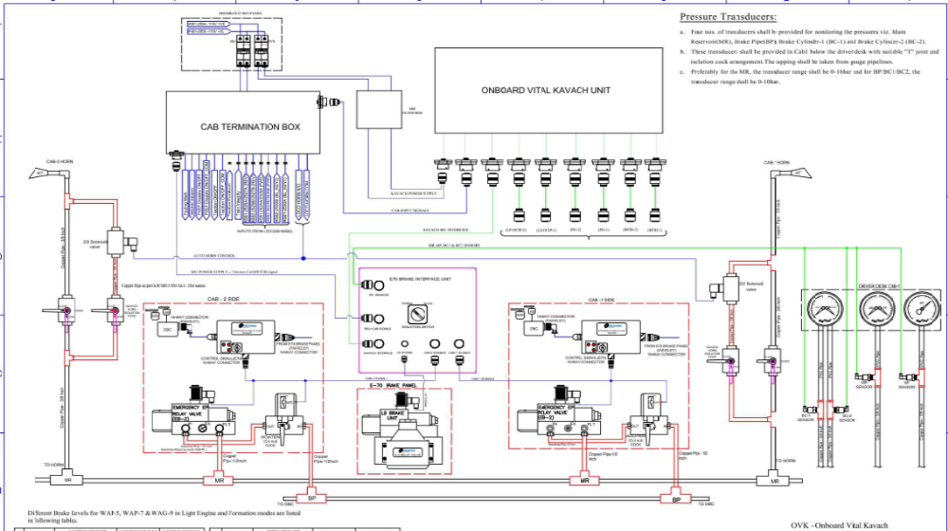
Interfacing with E70 (FTRTIL) Brake System
(WAP5,WAP7,WAG9)

Slide 3
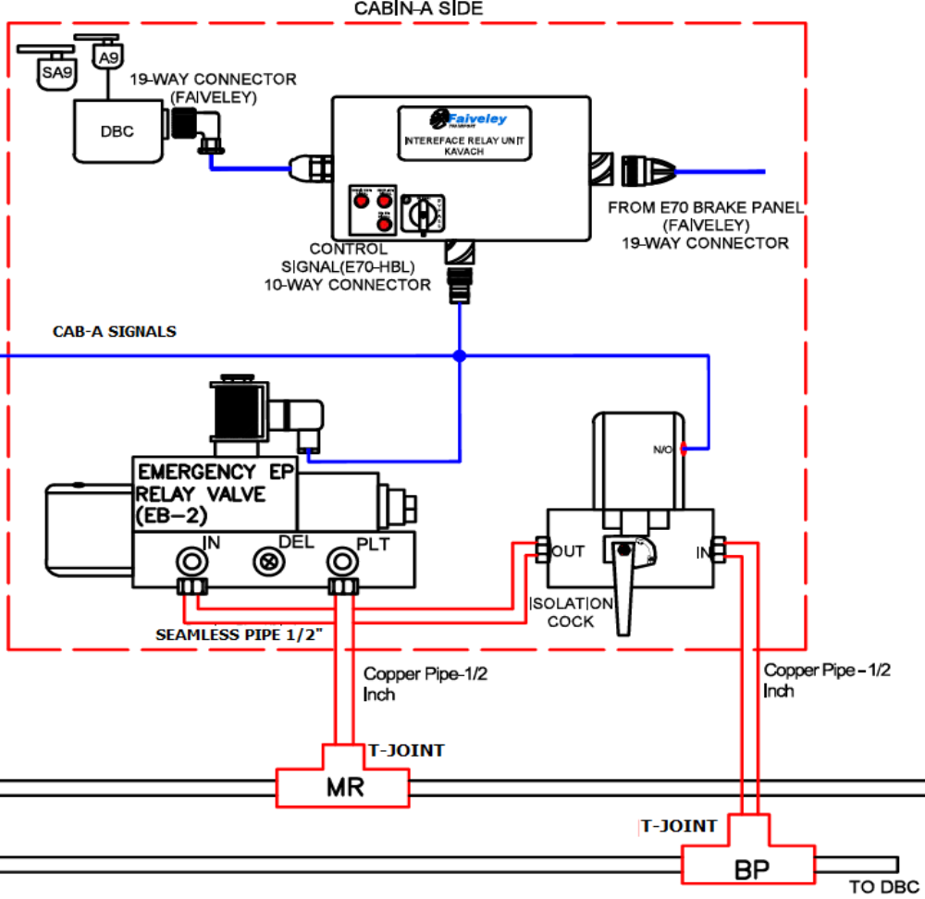
Pneumatic valves and components used (from FTRTIL)
Faively Equipment Pneumatic Interface: CAB-A
1. As shown in the figure, “Seamless pipe 1/2” and “Copper pipe 1/2”” are supplied in the loco kit.
2. Seamless pipe is connected between Emergency Relay Valve at “IN” terminal and BP Isolation cock at “OUT” terminal.
3. T-Joint is provided in MR path, Copper pipe 1/2” is connected from T-Joint to Emergency Relay Valve at “PLT” terminal.
4. T-Joint is provided in BP path, Copper pipe 1/2” is connected from T-Joint to BP Isolation cock at “IN” terminal.
5. Ensure that air-leakage is not there at joints.

Slide 4
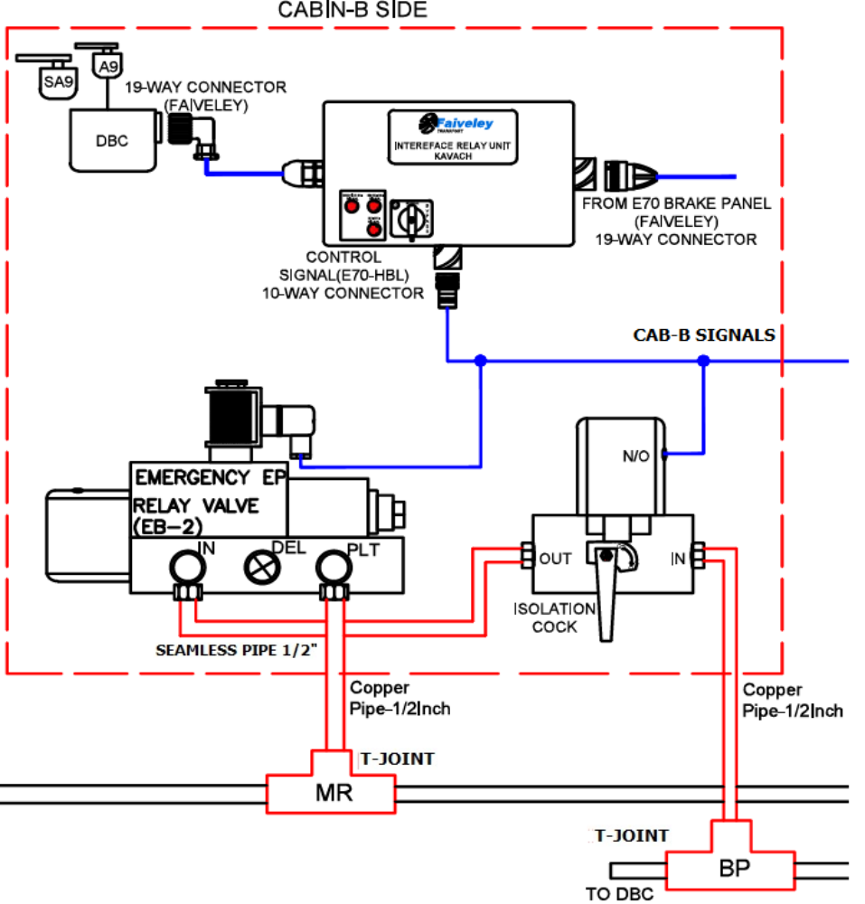
Pneumatic valves and components used (from FTRTIL)
Faively Equipment Pneumatic Interface: CAB-B
1. As shown in the figure, “Seamless pipe 1/2” and “Copper pipe 1/2”” are supplied in the loco kit.
2. Seamless pipe is connected between Emergency Relay Valve at “IN” terminal and BP Isolation cock at “OUT” terminal.
3. T-Joint is provided in MR path, Copper pipe 1/2” is connected from T-Joint to Emergency Relay Valve at “PLT” pilot terminal.
4. T-Joint is provided in BP path, Copper pipe 1/2” is connected from T-Joint to BP Isolation cock at “IN” terminal.
5. Ensure that air-leakage is not there at joints.

Slide 5
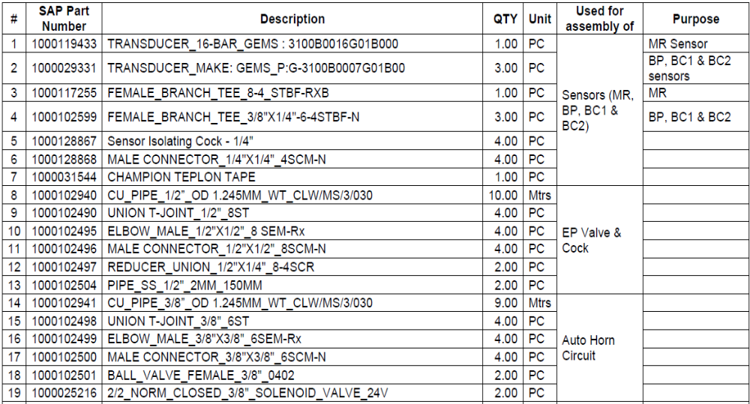
Pneumatic valves and components used (E70-FTRTIL)

Slide 6
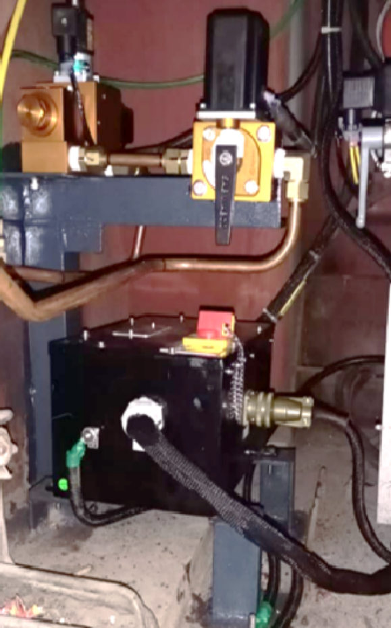
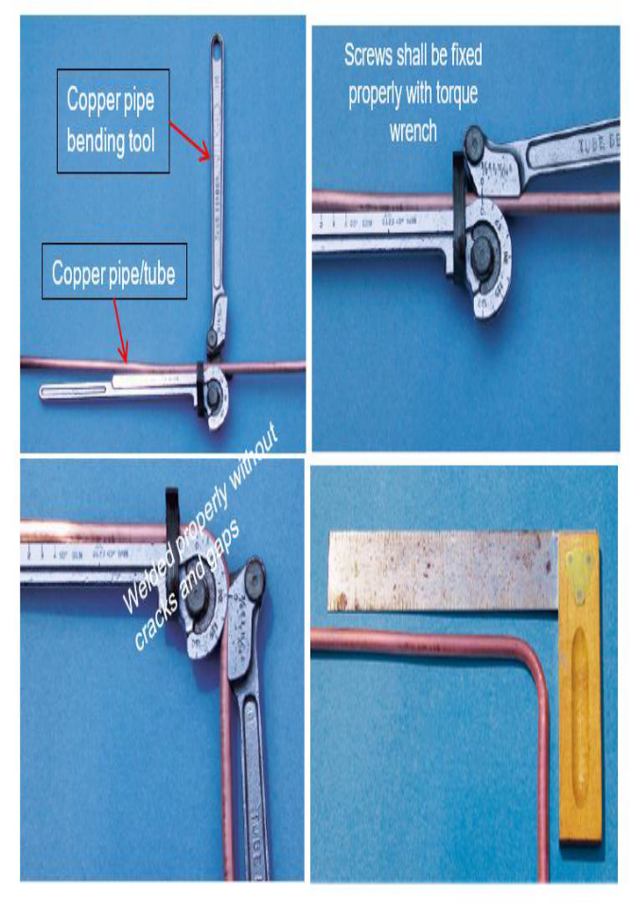
Pneumatic valves and components used (from FTRTIL)
Faively Equipment Pneumatic Interface: CAB-B
1. Copper pipes shall be bent using appropriate bending tool, ensuring that there are no kinks or sharp bends in the pipe.
2. Copper tube lengths shall be measured based on locations of EP Valve, BP cock, Horn cock and valve arrangements, to their respective connecting locations, as shown.
3. Copper pipe connections shall be made properly with approved make (Ex.Fluid Control) ferrules and TEE-joints, supplied in the Installation Kit.
4. Ensure that there are no loose connections in the pneumatic lines, by checking with soap solution.
5. No air bubbles shall be seen when soap solution is applied at the joints. After the test, the soap solution shall be wiped clean

Slide 7
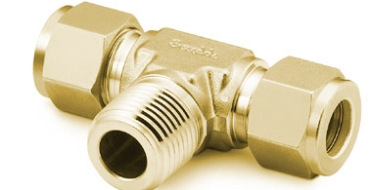
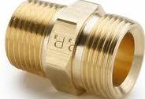
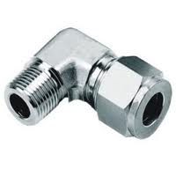
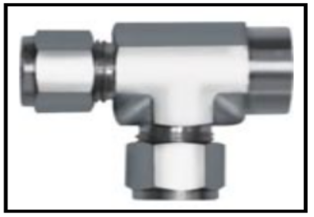
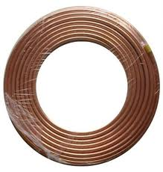
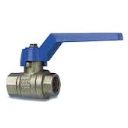
Pneumatic Components
T – connector
Male-female connector
Elbow connector
FEMALE_BRANCH_TEE_8-4_STBF-RXB
FEMALE_BRANCH_TEE_3/8"X1/4"-6-4STBF-N
Copper pipe
Ball cock 3/4"

Slide 8
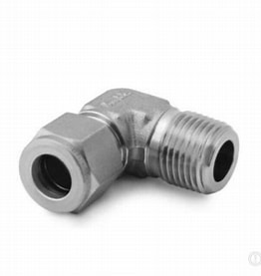
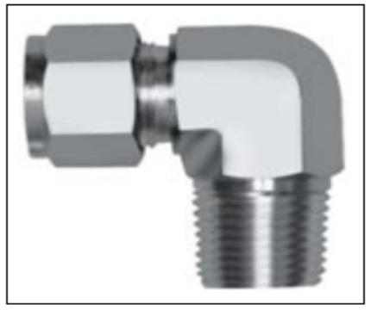
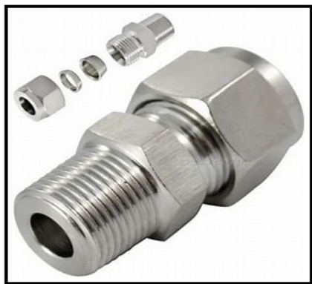
Pneumatic Components
ELBOW_MALE_1/2"X1/2"_8 SEM-Rx
ELBOW_MALE_3/8"X3/8"_6SEM-Rx
MALE CONNECTOR_3/8"X3/8"_6SCM-N
Male connector 1/4” x 1/4”-4SCM N

Slide 9
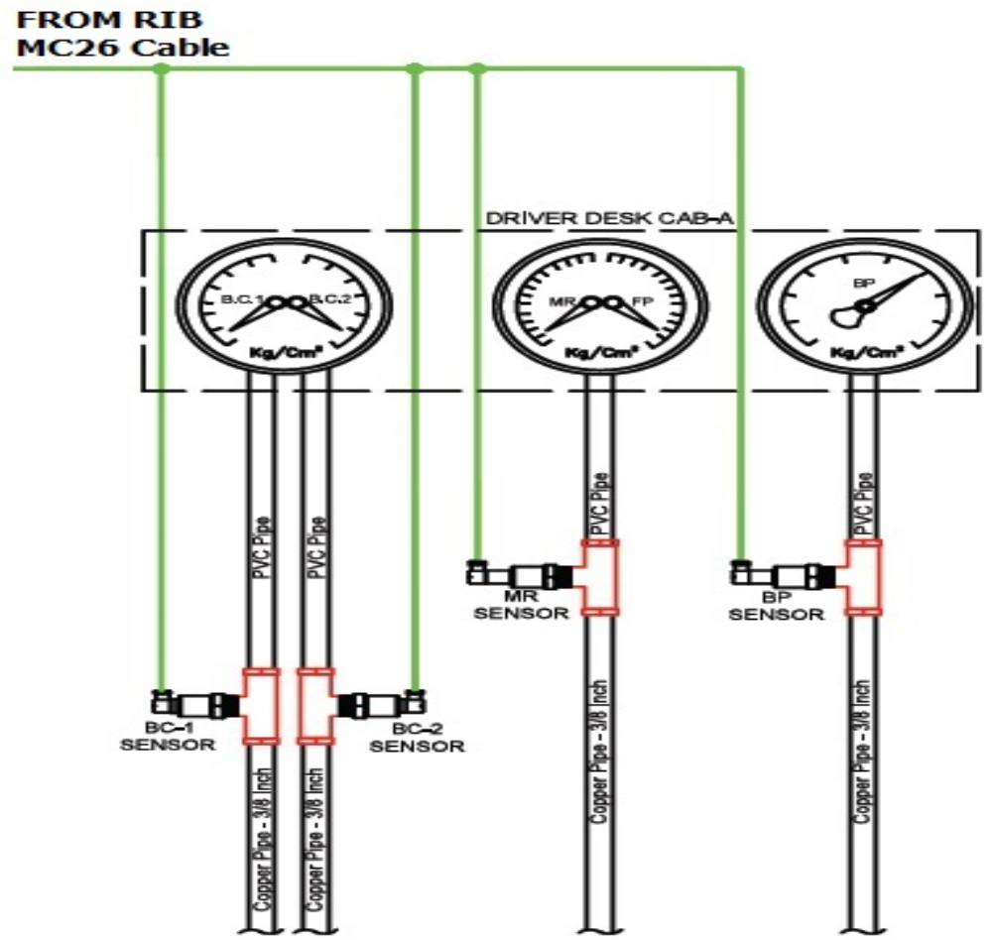
Pressure Sensors Installation & connectivity
1. The Pressure sensors are installed in MR, BP, BC1 & BC2 pneumatic line path, as shown.
2. T-Joint is installed in each pneumatic path.
3. Pressessors sensors are installed in T-Joint.
a. MR - 16bar
b. BP - 7bar
c. BC1 & BC2-7bar
4. Sensors installed picture shown in next slide.

Slide 10
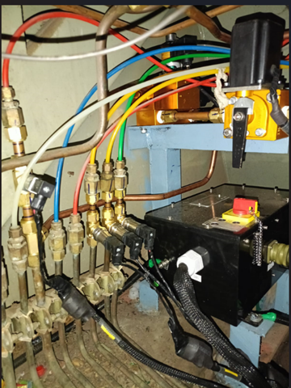
Pressure Sensors Installation & connectivity
The Pressure sensors are installed in MR, BP, BC1 & BC2 pneumatic line path, as shown above

Slide 11
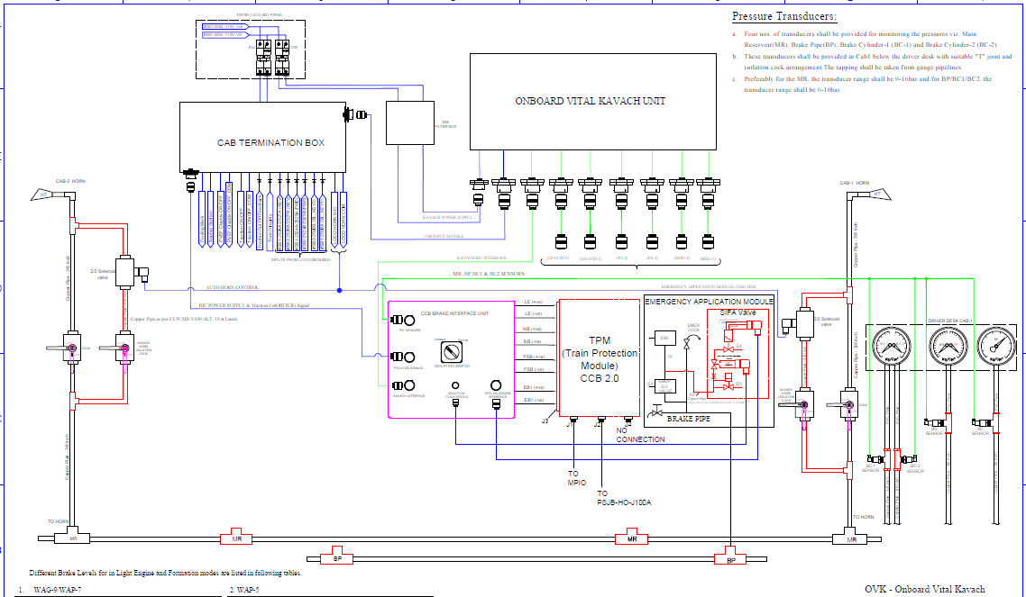
Interfacing with CCB 2.0 (KBIL) Brake System
(WAP5,WAP7,WAG9)

Slide 12
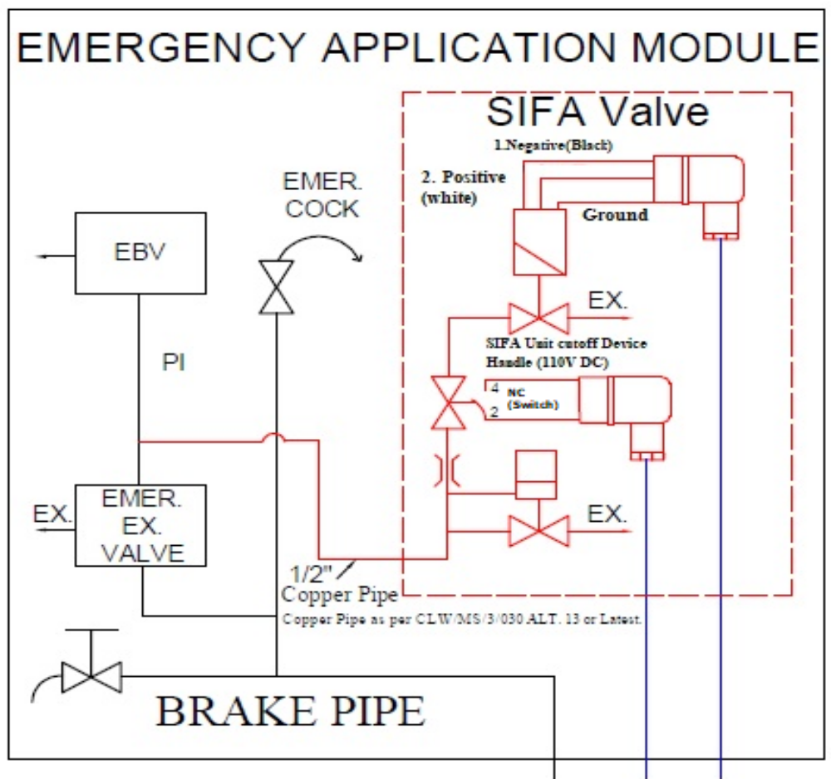
Interfacing with CCB 2.0 (KBIL) Brake System
(WAP5,WAP7,WAG9)
1. SIFA Valve IN port shall be connected to BP line.
2. A ½” T-joint shall be fitted in the BP line, as shown.
3. A ½” elbow fitting shall be fitted to the IN port of SIFA valve..
4. Length of copper pipe required to connect from the BP line T-joint to the SIFA Valve elbow fitting,shall be measured, cut, bent and
installed.
5. Proper bending tools shall be used for bending the copper pipe, to avoid kinks or pin holes

Slide 13
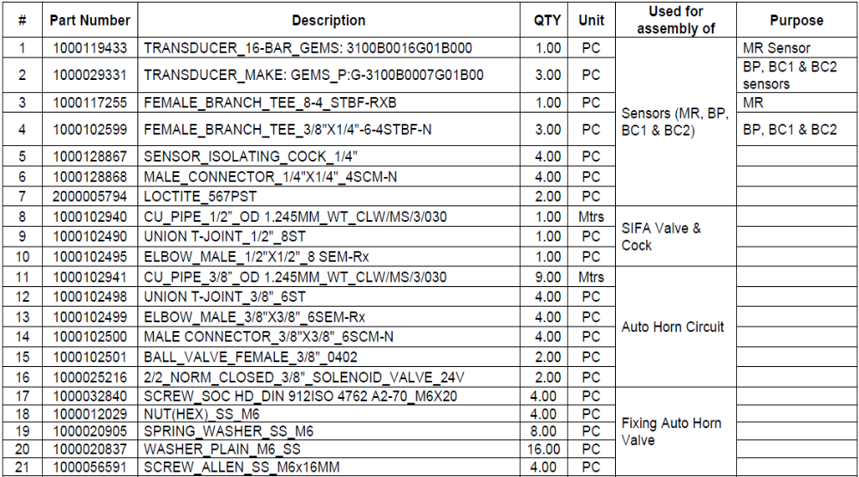
Pneumatic valves and components used (CCB-KBIL)

Slide 14
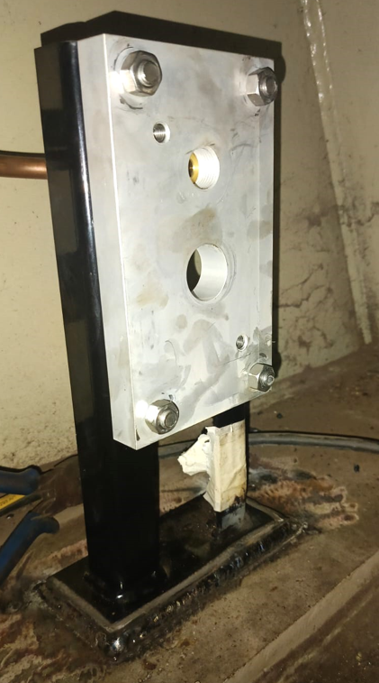
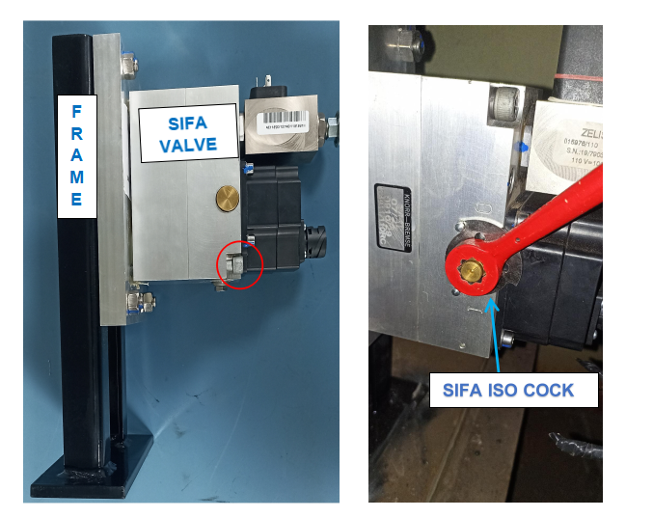
CCB Brake Interface Unit
1/2” ELBOW on SIFA valve frame

Slide 15
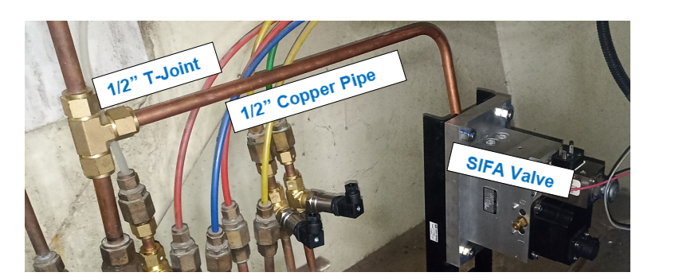
CCB Brake Interface Unit

Slide 16
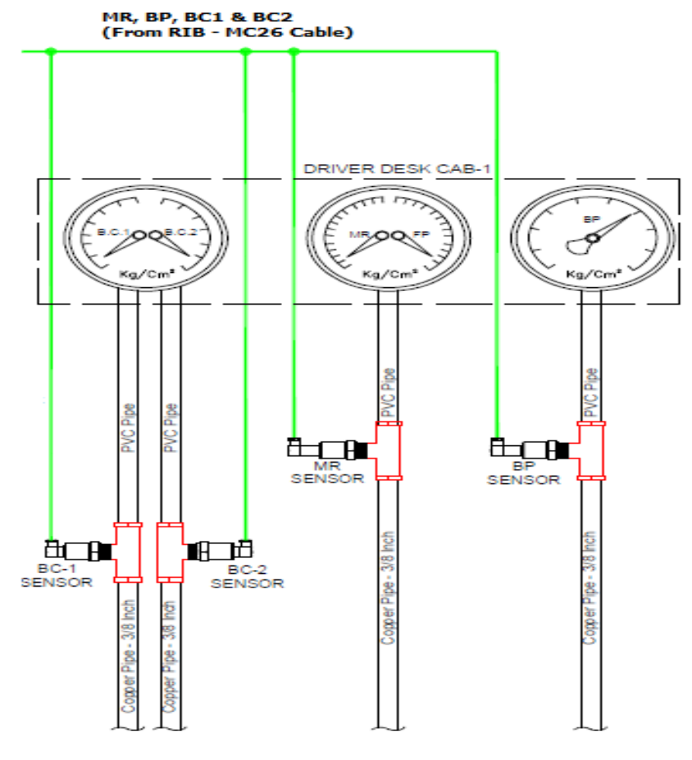
Pressure Sensors Installation & connectivity
1. The Pressure sensors are installed in MR, BP, BC1 & BC2 pneumatic line path, as shown.
2. T-Joint is installed in each pneumatic path.
3. Pressessors sensors are installed in T-Joint.
a. MR - 16bar
b. BP - 7bar
c. BC1 & BC2-7bar
4. Sensors installed picture shown in next slide.

Slide 17
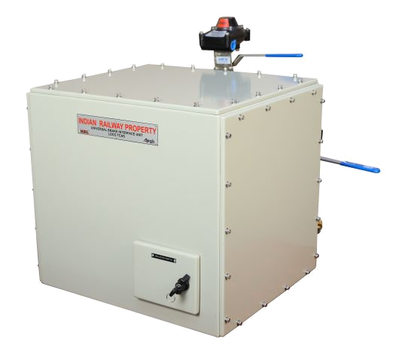
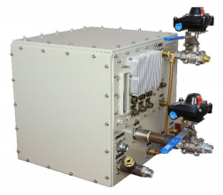
Braking interface unit (UBIU)-IRAB
BIU Rear view
BIU Front view

Slide 18
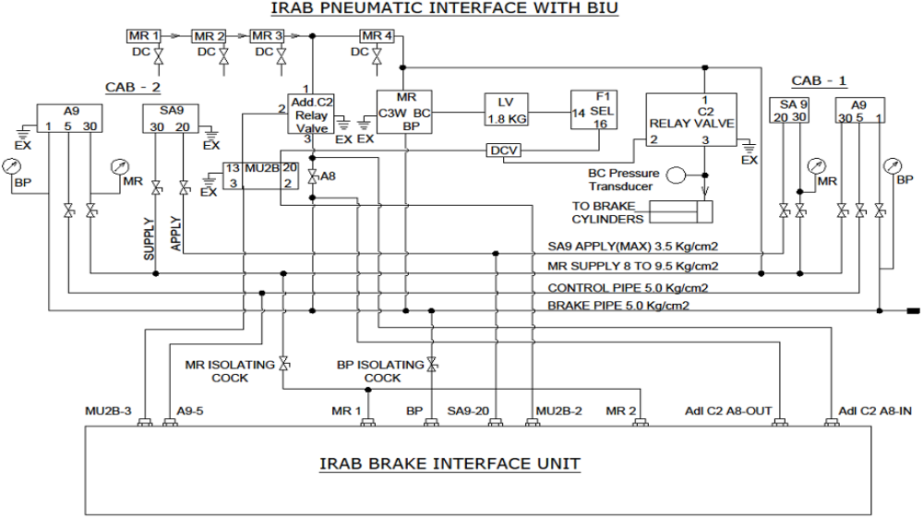
Braking interface unit (UBIU)-IRAB

Slide 19
LTCAS Pneumatic Interfaces
# | Pneumatic | Pneumatic Connection at UBIU
1 | MR to UBIU | a. Pneumatic piping from MR to ON/OFF valve. b. Pneumatic piping from ON/OFF valve to MR sensor. c. Pneumatic piping from MR Sensor to BIU
2 | BP to UBIU | a. Pneumatic piping from BP to ON/OFF valve. b. Pneumatic piping from ON/OFF valve to BP sensor. c. Pneumatic piping from BP Sensor to BIU
3 | BC Sensor | Installing BC pressor Sensor in BC pipe.
4 | A9-5 | Pneumatic piping from Loco controller pipe to A9-5 of BIU
5 | SA9-20 to UBIU | Pneumatic pipingfrom SA9-20 of BIU (LE input) to Loco SA9 pipe
6 | MU2B-2 to UBIU | Pneumatic piping from Loco MU2B-2 (LE output) to MU2B-2 of BIU
7 | MU2B-3 to UBIU | Pneumatic piping from MU2B-3 of BIU to Loco MU2B-3
8 | Addl C2 A8 In to UBIU | Pneumatic piping from Loco Addl C2 - A8 (input side) to Addl C2 A8 IN of BIU, as shown in the diagram (This connection is for future use)
9 | Addl C2 A8 OUT to UBIU | Pneumatic piping from Addl C2 A8 OUT of BIU to Loco Addl C2-A8 (output side), as shown in the diagram (This connection is for future use)

Slide 20
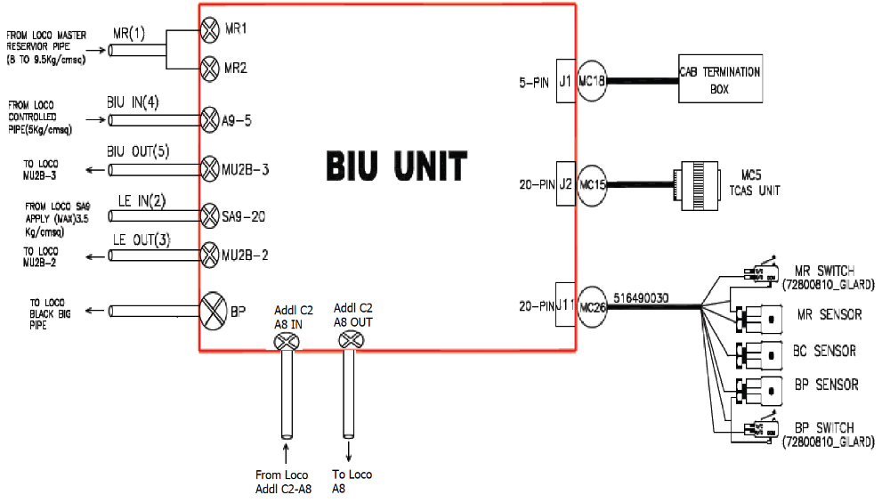
LTCAS Pneumatic Interfaces

Slide 21
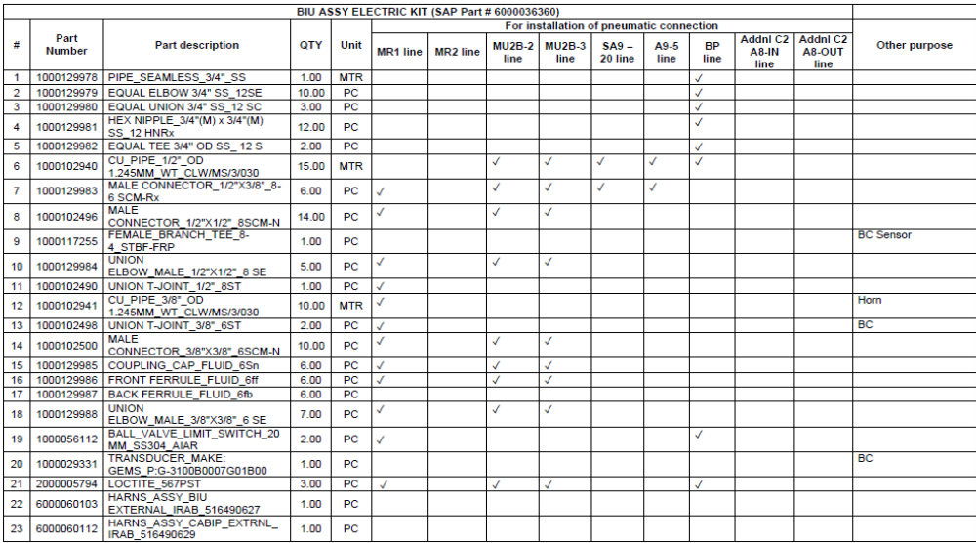
Pneumatic valves and components used (UBIU - IRAB)

Slide 22
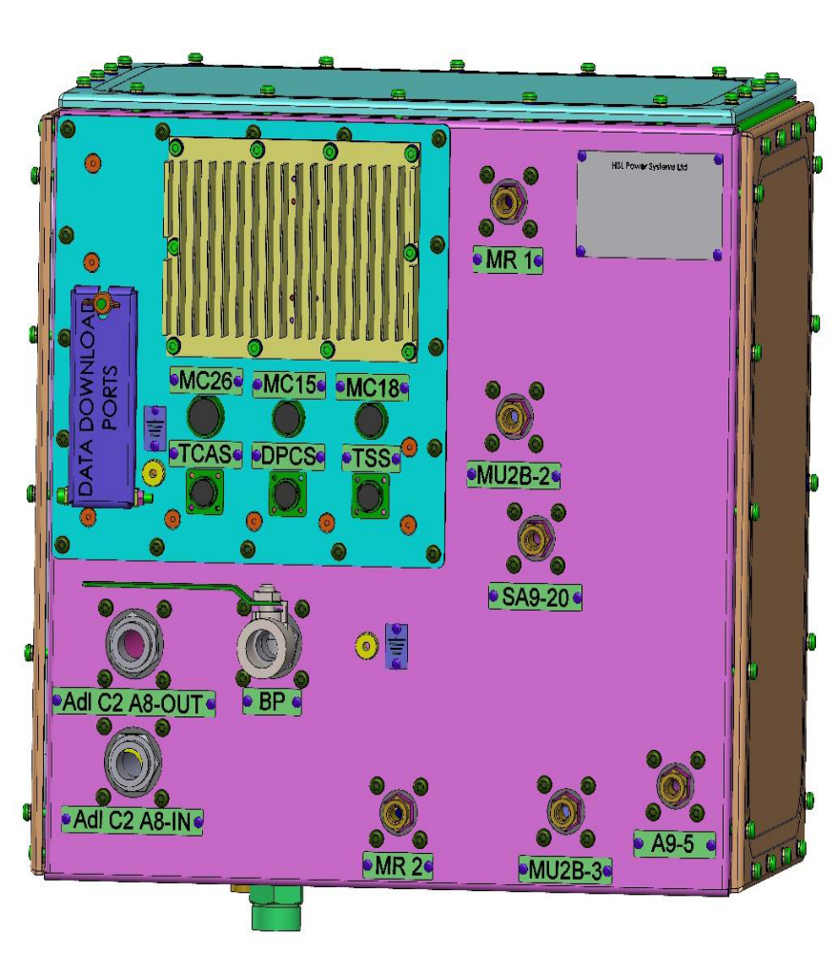
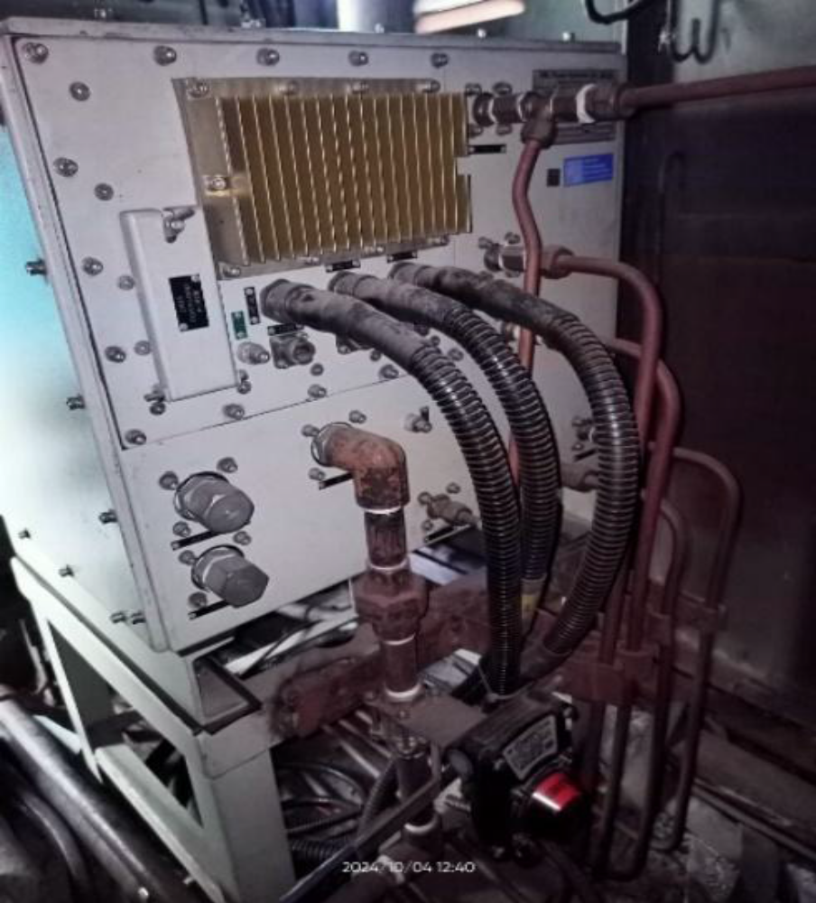
LTCAS UBIU Pneumatic connections
BIU Rear view

Slide 23
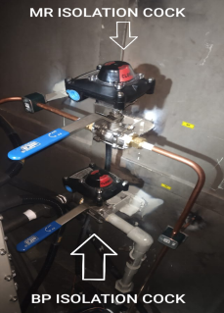
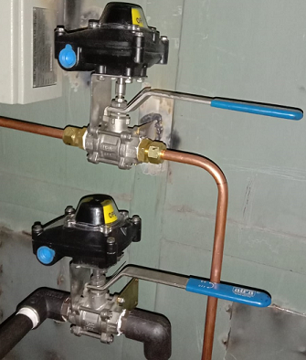
MR & BP Cocks - IRAB LTCAS
MR COCK & BP COCK
OFF Position
MR COCK & BP COCK
ON Positon

Slide 24
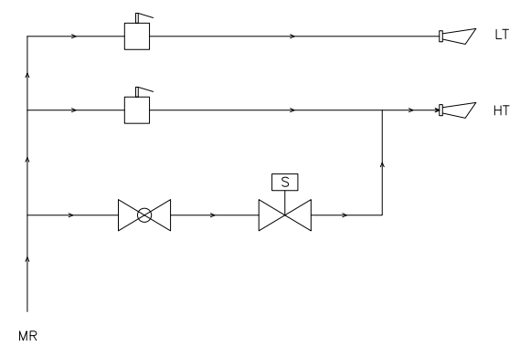
Auto Horn Pneumatic Interface
HT, LT – Loco Pilot (LP) operating switches .
Auto Horn Interface Pneumatic is provided between HT and MR pneumatic circuit.
Solenoid (S) – 24V operating Valve is provided.
ON/OFF – Valve (ball cock) is provided between Solenoid and MR
Auto Horn Pneumatic Interface Between HT Switch and MR Pipe

Slide 25
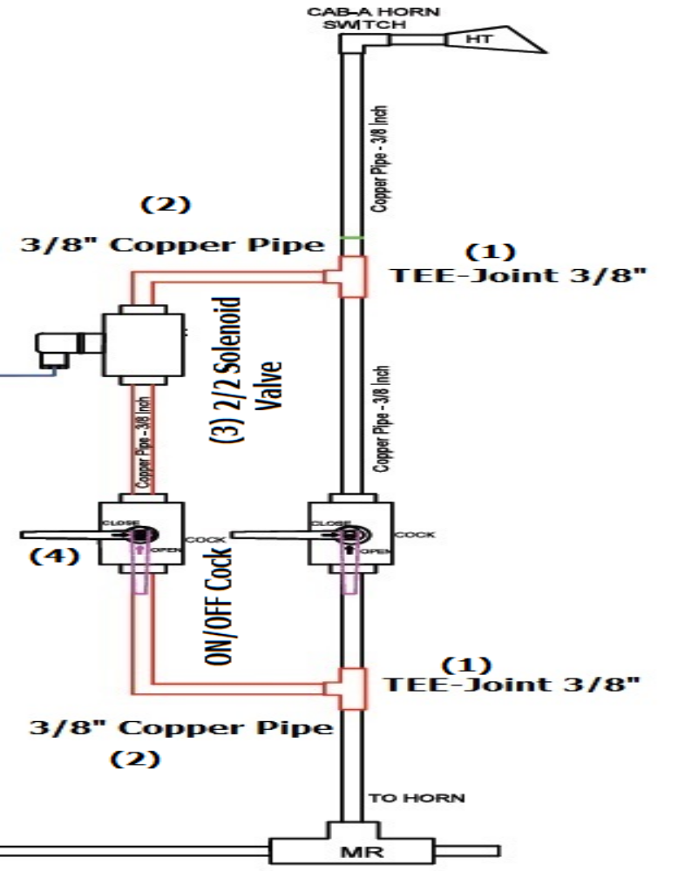
Auto Horn Pneumatic Interface
Part Details:
Tee Joint 3/8” - 2nos for each CAB.
3/8” Copper pipe (As required).
2/2 Solenoid Valve (24V operating) – 1no for each CAB, (2 - is MR IN & 1- is MR OUT)
ON/OFF – 3/8” Ball Valve (Rotex) - 1no for each CAB is provided.

Slide 26
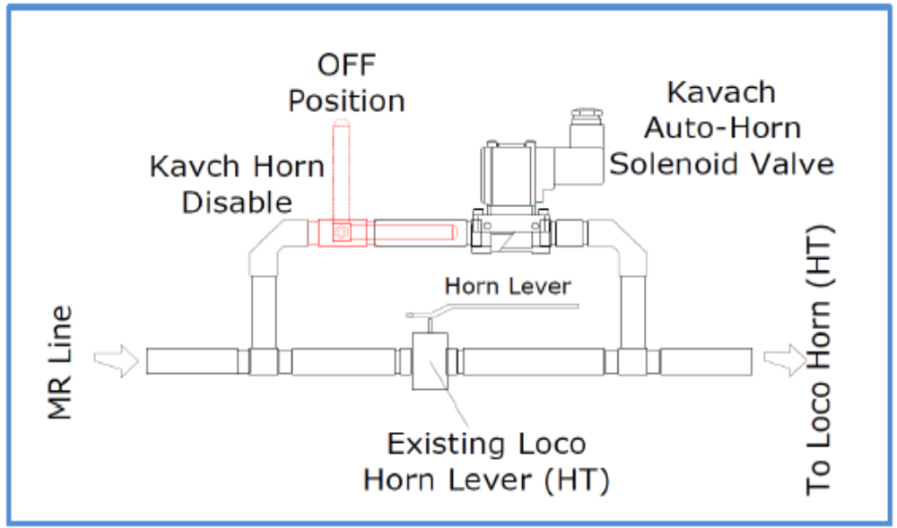
Auto Horn Pneumatic Interface

Slide 27
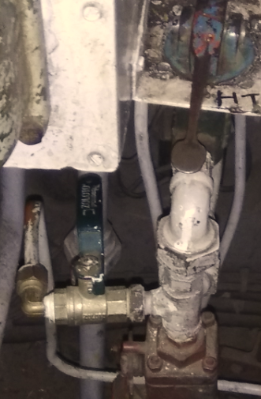
Auto Horn Pneumatic - ON / OFF Ball Cock

Slide 28
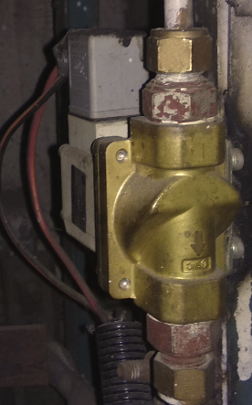
Auto Horn Pneumatic ON/OFF Solenoid Valve

Slide 29


Thank You
www.hbl.in

